Slide 1
The Effort Savings from Using NLP to Classify Equivalent Requirements
DAVIDE FALESSEI : Prof of CS
Simula Research Laboratory (Norway)
GIOVANNI CANTONE : Prof of software intensive-system analysis and design
Presented by:
Sindhusha Tiyyagura (16280708)
Pradeepika Kolluru (16283597)

Slide 2
Main aim of research paper
“This article concerns a study that merges the results of an industrial case study and a controlled experiment to obtain control and realism. The natural-language processing (NLP) technique employed is expected to reduce effort by an average of 12%, compared to not using NLP.”
12% effort reduced – using best NLP technique
9% effort increased – using non-suitable NLP technique
25% effort increased – using non-suitable NLP technique compared with best NLP

Slide 3
Need for Classifying Equivalent Requirements?
Different systems with similar requirements create an opportunity to eliminate redundant work.
Based on our industrial experience, requirements tend to be redundant due to
a large number of requirements per project
several concurrent system development Projects
requirements that are elicited and written by several analysts who belong to different projects or different departments

Slide 4
Using NLP to Classify
TraceLab: ( Open source tool) provides a great opportunity to easily identify similarities among requirements through the use of several NLP techniques.
NLP techniques are not perfect and they are not completely reliable
Each NLP technique provides different similarity measures – resulting in different levels of reliability

Slide 5
Reliability
Reliabilty = 1 - | similarity_measure - experts_classification|
Similarity measure ranges from 0 to 1 [0,1]
Expert’s Classification either 0 or 1
So Reliability ranges from [0,1]
Regardless of classification, reliability is interpreted as 1 in case of perfect agreement and 0 in case of perfect disagreement

Slide 6
Industrial Case Study
Discussions of classifications ensued until complete agreement among experts was reached.
Distribution of reliability of different NLP techniques for industrial requirement pairs.
Example:
“The system shall provide a mechanism to allow the interaction among and within systems of type B”
“To enable cooperation, the system must support the interaction among and within B systems.”
Challenge is not the complexity of comparing each pair but evaluating huge number of pairs.
Notes:
discussions of classifications ensued until complete agreement among experts was reached.

Slide 7
Case Study Approach
Consolidating the requirements at SELEX SI by a team of 4 domain experts:
Checking the Quality of requirements using PROUD tool
Categorize requirements according to predefined industrial taxonomy
Commonality identification using the PROUD tool
PROUD ranks the requirement pairs in descending order according to the similarity measure.
Experts go over the ranked order and classifies whether the requirement pair is equivalent or not.

Slide 8
Case study Results
12 hour interactive group meeting to classify each requirement pair.
Classified 983 pairs out of 3 million requirement pairs
Team Average Speed per classification = 12 * 24 * 24 / 983 = 44 seconds
Out of 983 - 138 are classified as equivalent
- Partial overlap in the requirements are classified as non-equivalent.

Slide 9
Case study Results
Sampled the requirement pairs from the population of 3 million pairs
Analysing top pairs as ranked by PROUD.
Analysed 316 pairs – stopped after finding 76 non equivalent pairs in a row
Random sampling without replacement.
Remaining 667 pairs – All of them turned out to be non equivalent.
Did PROUD ranking tool really help the experts???
Notes:
To detect more number of equivalent req pairs from the 3 million sets

Slide 10
Case Study Results
NPL techniques are not perfect and not completely reliable.
So, they decided to measure the reliability of different NLP techniques from the industrial data set of 983 requirement pairs.
Plotted the graph for reliability distributions of 10 different NLP techniques ( chooses from 242 )
6 out of 10 NLP techniques showed more agreement
( with average reliability > 0.5)
Notes:
To detect more number of equivalent req pairs from the 3 million sets
Help experts reduce their effort

Slide 11
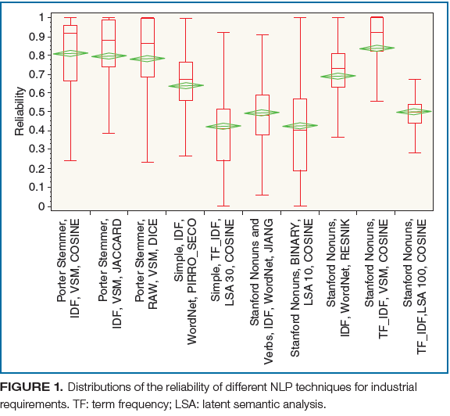
Results
Notes:
To detect more number of equivalent req pairs from the 3 million sets
Help experts reduce their effort

Slide 12
Experiment
to assess and model the impact of using the similarity measurement and its reliability on the effort of analysts in classifying equivalent requirements.
Notes:
To detect more number of equivalent req pairs from the 3 million sets
Help experts reduce their effort

Slide 13
Experiment Design
Experiment subjects were 32 master’s students taking graduate course in empirical software engineering.
Subjects classify the requirement pairs.
Using Linear Regression method ...
Independent Variable: two classification methods ( with and without similarity measure )
Dependent variable: effort ( seconds per classification )
Notes:
To detect more number of equivalent req pairs from the 3 million sets
Help experts reduce their effort

Slide 14
Experiment Design
Cross randomised design of two rounds
2 sets of 72 requirement pairs are sampled from the industrial set for each round.
Subjects classify 72 requirement pairs within a nominal duration of 45min for each round.
Subjects were assigned randomly to one of the two groups
So experiment design ensured that
same number of requirement pairs classified by same number of subjects,
with same proportion using or not using the similarity measure.
Notes:
To detect more number of equivalent req pairs from the 3 million sets
Help experts reduce their effort

Slide 15
Experiment Results
Standard Least squares Regression method Equation:
Speed = b0 + b1M + b2MR
Average effort without similarity measure = 19.95 sec/classification
Effort varied from 17s to 23s per classification based on the reliability
Using similarity measure was beneficial above 0.6 of reliability.
Notes:
To detect more number of equivalent req pairs from the 3 million sets
Help experts reduce their effort

Slide 16
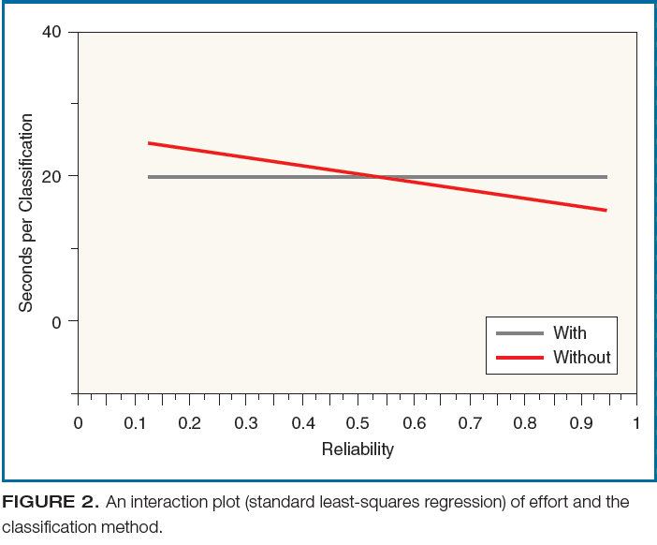
Results
Notes:
To detect more number of equivalent req pairs from the 3 million sets
Help experts reduce their effort

Slide 17
Experiment Results
Statistical details of least squares regression method.
Interaction effect between the classification method and reliability on effort is statistically significant ( p-value < 0.001 )
Main effect of method is not significant ( p-value is 0.655)
Low standard error of the model says that it is accurate
Conclusion: Effort spent by the analyst in classifying requirement pairs changes according to the specific NLP technique used.
Notes:
To detect more number of equivalent req pairs from the 3 million sets
Help experts reduce their effort

Slide 18
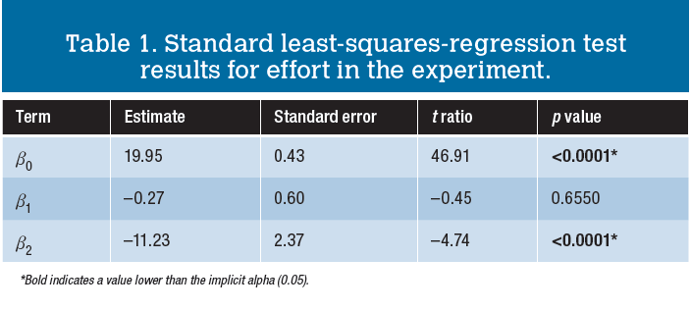
Results
Notes:
To detect more number of equivalent req pairs from the 3 million sets
Help experts reduce their effort

Slide 19
Merging Results
Industrial case study: reliability levels of different NLP techniques
Experiment: how subjects perform at different reliability levels.
Combining Results: effort savings by use of different NLP techniques
Notes:
Figure 3 = figure 1 + figure 2

Slide 20
Merging Results
1) From Best NLP Technique:
Average Expected effort savings using porter Stemmer NLP technique = 2.54s per classification.
effort decreases from 19.95s → 17.48s per classification
i.e 12% ( 2.54/19.95 ) decrease in the effort
2) From Worst NLP technique:
Average Expected effort savings using Simple NLP technique = -1.87s per classification.
i.e 9% (1.87/19.95 ) increase in the effort
i.e 25% ( 1.87/17.48) increase in effort compared to best NLP technique
Notes:
Figure 3 = figure 1 + figure 2

Slide 21
Final Results
 | Without NLP (19.95s/classification) | Using best NLP (17.48s/classification) | Using Worst NLP (21.82s/classification)
Time for classifying 983 Requirement pairs | 5.45 person-hours | 4.7 person-hours | 5.95 person-hours
Time for classifying 3 million Requirement pairs | X | X - 15 person-months | X + 11 person-months
Notes:
Figure 3 = figure 1 + figure 2

Slide 22
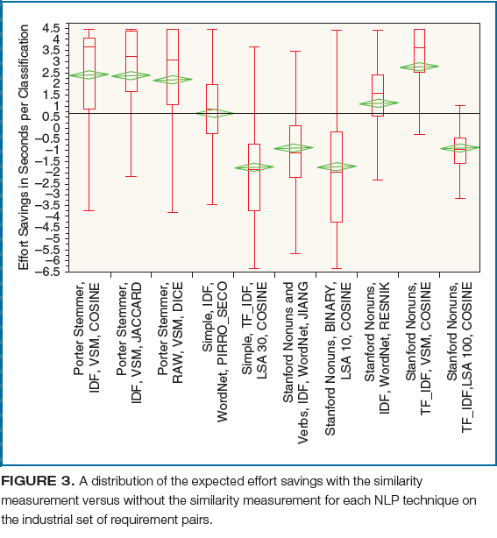
Final Result
Notes:
Figure 3 = figure 1 + figure 2

Slide 23
Validity Threats:
Cross randomised design enables subjects to apply or not apply the changes in random order.
Forces subjects to analyse the entire sets within specific amount of time.
Used Balanced proportion of non-equivalent requirements
Reliability is computed based on the expert’s classification
Sanitizing industrial requirements for the experiment
Students Vs Professionals
Notes:
Figure 3 = figure 1 + figure 2

Slide 24
Related Work:
“A practical guide to product line scoping” report industrial case study where information retrieval techniques reduced the analysts cognitive load by 60%.
Other paper report a controlled experiment where the adoption of the ReqSimile tool improved correctness and decreased effort in linking similar requirements.
However, The Uniqueness of the research paper compared to other similar studies are:
Cross randomized design
Balanced proportion
Combination of industrial case study and experiment to achieve control and realism
Notes:
Figure 3 = figure 1 + figure 2

Slide 25
Conclusion
Even though NLP techniques have been the subjects of several research investigations, still cannot compare which one is better than another in specific contexts.
Future Work: Effort saving using NLP techniques to establish requirement relations like ( inclusion, exclusion) different from equivalence.
Notes:
Figure 3 = figure 1 + figure 2

Slide 26
Thank you

